Slide 1
What’s
their
job?

Slide 2
They are YouTubers.

Slide 4
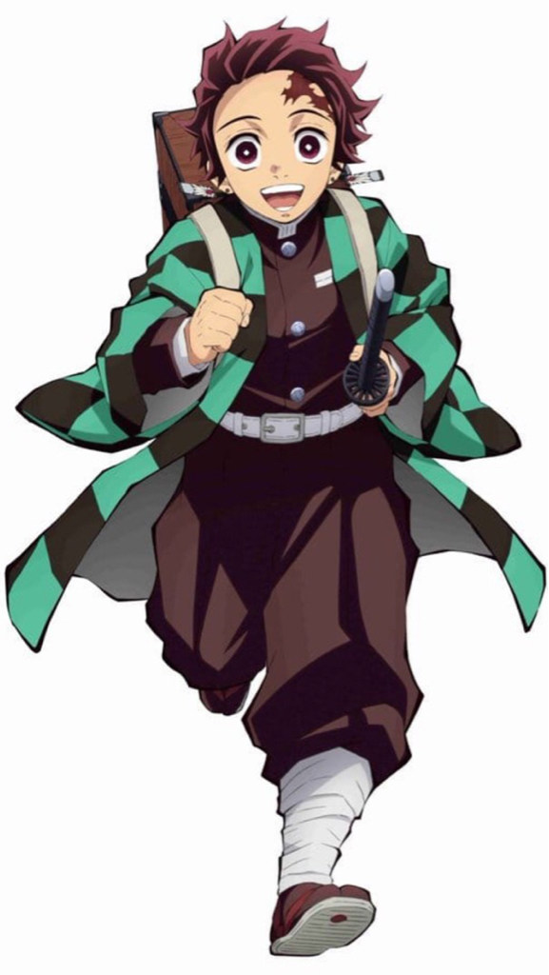
Did you finish your homework?
Maybe…yes!

Slide 5
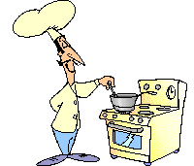

Slide 6
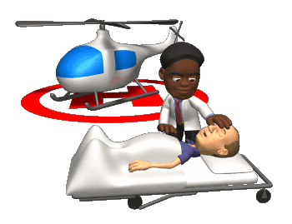
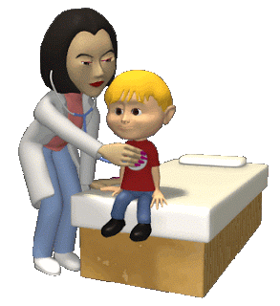

Slide 7
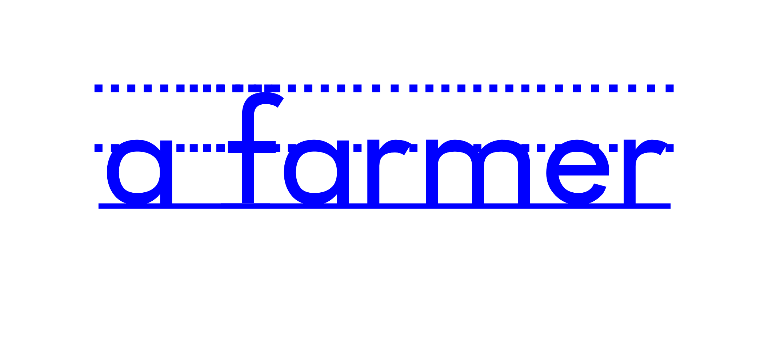

Slide 8
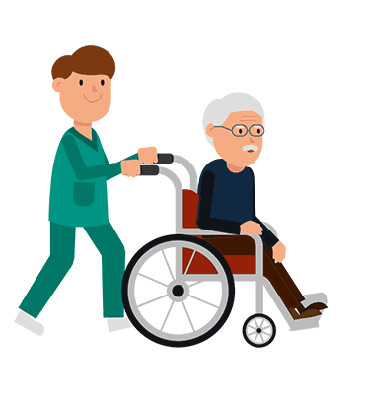
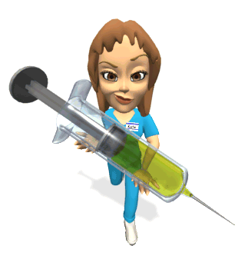

Slide 9
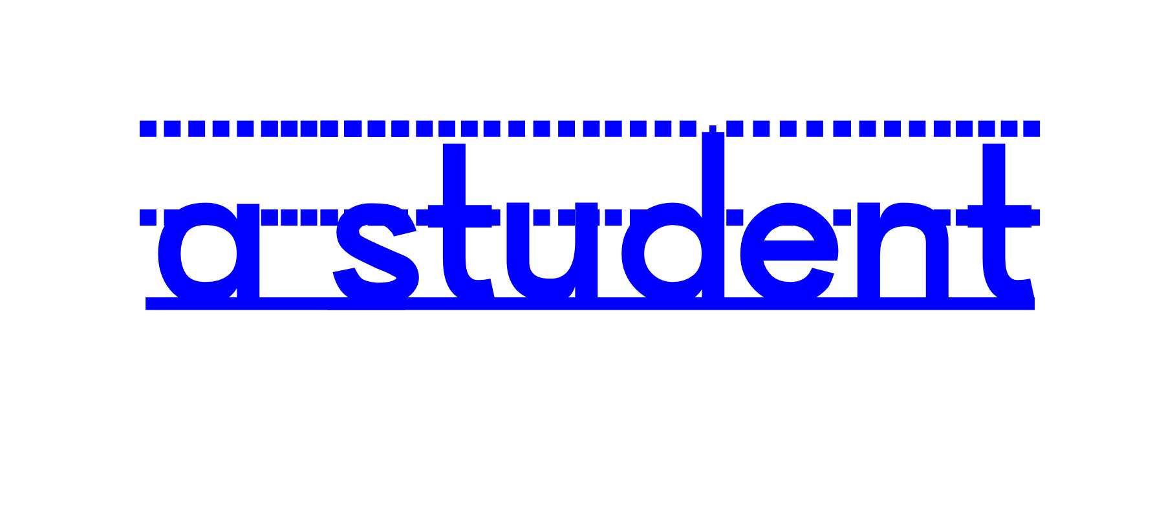
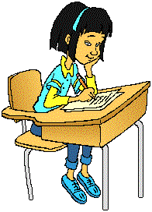

Slide 10
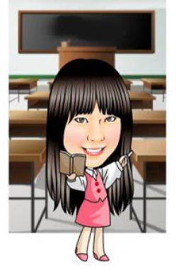

Slide 12
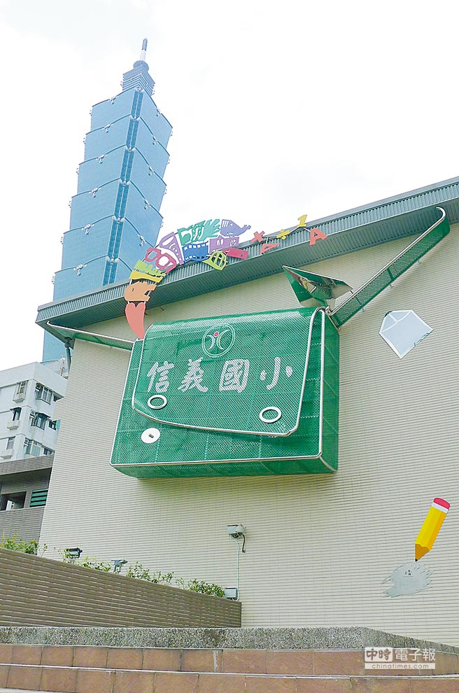
Are you a student?
Yes, I am.

Slide 13
Are you a cook?
No, I’m not.

Slide 14
Is he a teacher?
Yes, he is.

Slide 15
Is she a doctor?
No, she isn’t.

Slide 16
名人Q&A

Slide 17
Is she a student?
Yes, she is.

Slide 18
Is he a cook?
No, he isn’t.
He’s a doctor/ mayor.

Slide 19
Is she a nurse?
No, she isn’t.
She’s a singer/ dancer.

Slide 20
Is he a teacher?
No, he isn’t.
He’s a president of the USA.

Slide 21
Is he a student?
Yes, he is.
No, he isn’t.
He’s a detective.

Slide 22
名人Q&A part 2

Slide 23
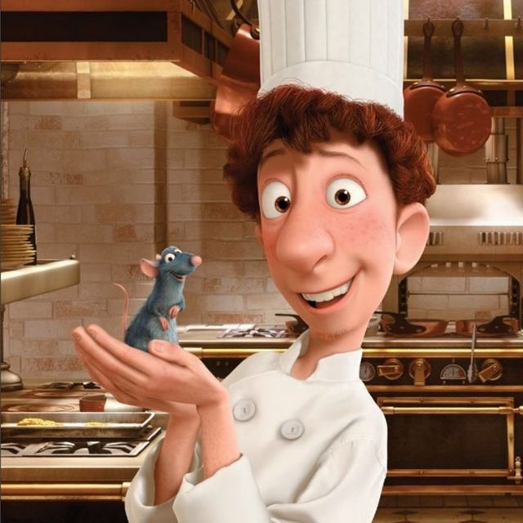
Is it a cook?
Yes, it is.

Slide 24
Is he a doctor?
No, he isn’t.
He’s a businessman/
superhero .

Slide 25
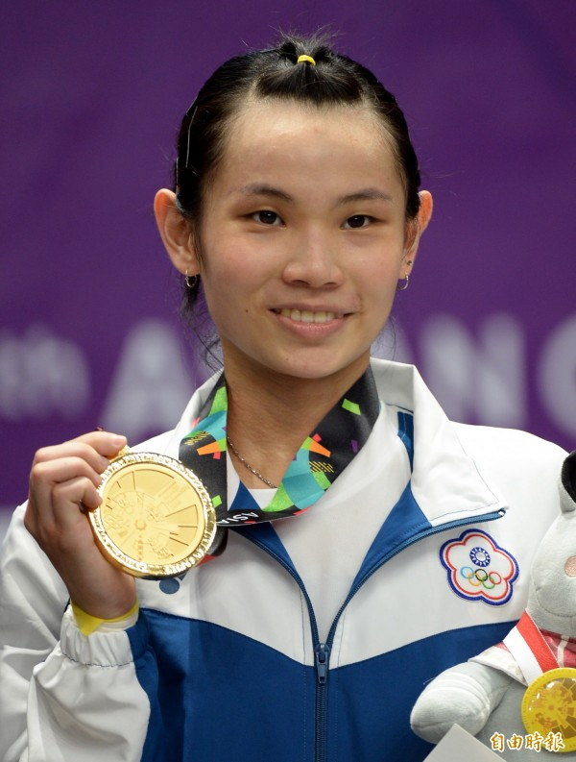
Is she a farmer?
No, she isn’t.
She’s a badminton player.

Slide 26
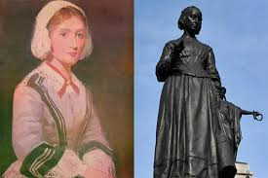
Is she a nurse?
Yes, she is.

Slide 27
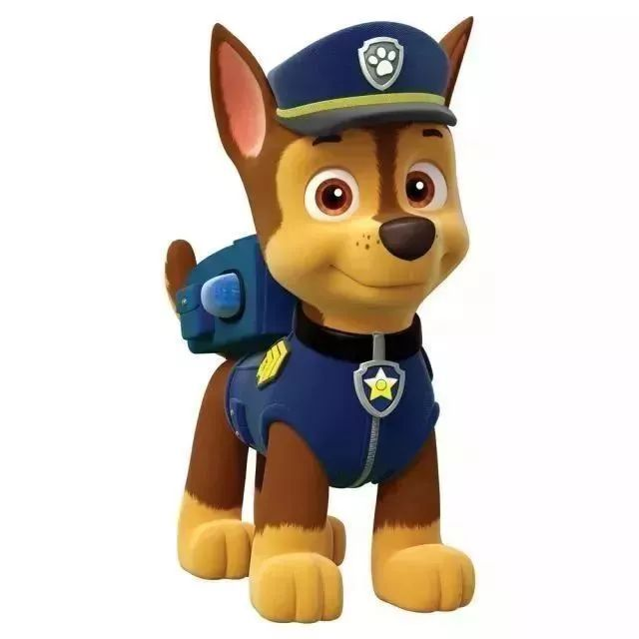
Is he a student?
No, he isn’t.
He’s a patrol.

Slide 28
Is he a doctor?
No, he isn’t.
He’s a teacher.

